Slide 1
Fitness Activity Tracker
Lalith(25RBAIM0067)
MD.Jaffar Pasha(25BAID0025)
MD.Nizam Uddin(25BAID0030)
Syed Taqveem (25RBAIM0080)

Slide 2
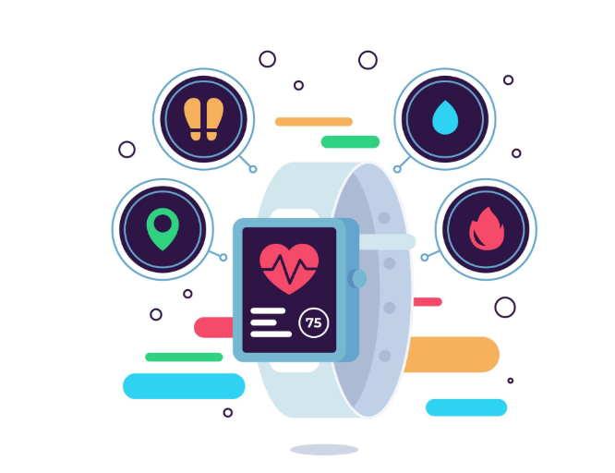
Introduction
A Fitness Activity Tracker is a digital system that monitors physical activities.
It tracks steps, distance, calories burned, and active minutes.
Helps users understand daily fitness levels.
Encourages a healthy and active lifestyle.
Used by individuals, athletes, and healthcare professionals.
Can be mobile apps, smartwatches, or wearable bands.

Slide 3
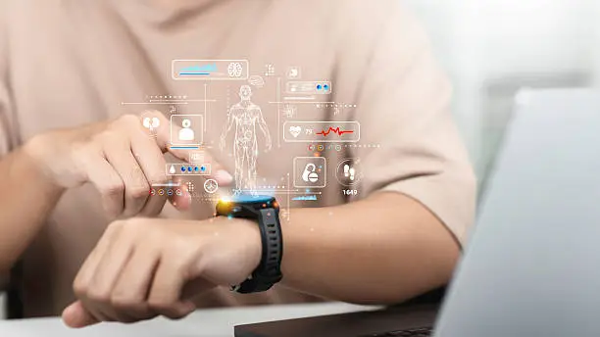
Key Features
Step counting using motion sensors.
Heart rate monitoring in real-time.
Sleep tracking for health analysis.
Calorie calculation based on activity.
Workout tracking (running, cycling, gym).
Goal setting and progress visualization.

Slide 4
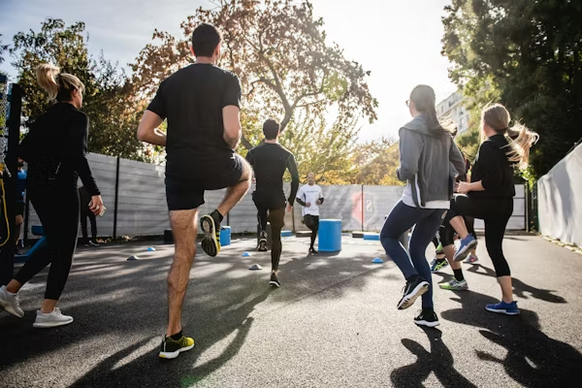
Benefits
Improves physical fitness awareness.
Motivates users through daily goals.
Helps maintain healthy routines
Tracks long-term health progress.
Useful for weight management.
Supports preventive healthcare.

Slide 5
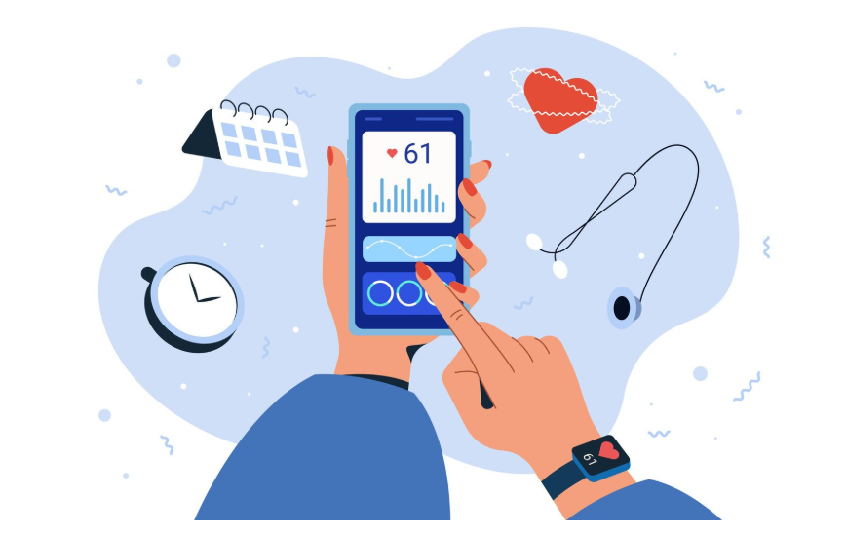
Applications
Personal fitness monitoring.
Sports and athletic training.
Medical health monitoring.
Corporate wellness programs.
Weight loss programs.
Rehabilitation and physiotherapy.

Slide 6

Future Scope
Integration with AI and machine learning.
Advanced health predictions.
Smart diet recommendations.
Integration with smart hospitals.
Mental health tracking features.
More accurate and compact wearable devices.

Slide 7


